Slide 1



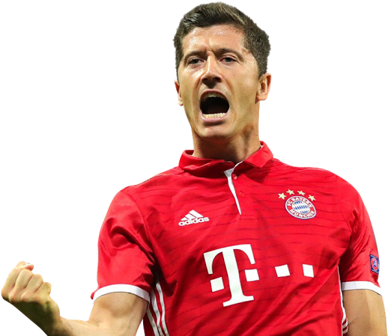
ROBERT LEWANDOWSKI
ROBERT LEWANDOWSKI
9
529 GOALS
530 GOALS
ROBERT LEWANDOWSKI
ROBERT LEWANDOWSKI
9
9
529 GOALS
530 GOALS

Slide 2
